Slide 1
“Predicting Barriers to Financial Inclusion Among Rural Youth in Kenya”
By Group 1:
Sylvanus Raringo,
Tom Musula
Christine Kindena,
Mark Chiuri,
Joel Kioko
Stanley Maina
Moringa School Date: 5th June 2025

Slide 2
Agenda:
Business Understanding
Objectives
Exploratory Data Analysis (EDA)
Data Preparation
Modeling Approach & Performance
Model Deployment
Conclusion & Recommendation

Slide 3
Business Understanding
Financial inclusion refers to the process of ensuring that individuals especially those in underserved or low-income areas have access to useful, affordable, and appropriate financial products and services delivered in a responsible and sustainable way.
According to the (FinAccess, 2024) household survey, only 59% of youth are financially included in Kenya.
Rural youth, aged 18-35,remain a key demographic facing disproportionate financial exclusion.
The goal of this project is to identify and predict the key barriers to financial inclusion among rural youth (18–35 years) in Kenya, and to enable targeted policy and intervention strategies.

Slide 4
Objectives
The objectives of the project include:
Identifying the key barriers to financial inclusion among the youth in rural Kenya.
Building a model for predicting financial inclusion
Generating insights that would be beneficial to the following stakeholders;
Government – in the design of targeted financial inclusion strategies & policy.
Financial institutions – in developing financial products that address existing gaps and to pre-screen/scoring for credit product eligibility.
NGOs and donors – in prioritizing areas of intervention.

Slide 5
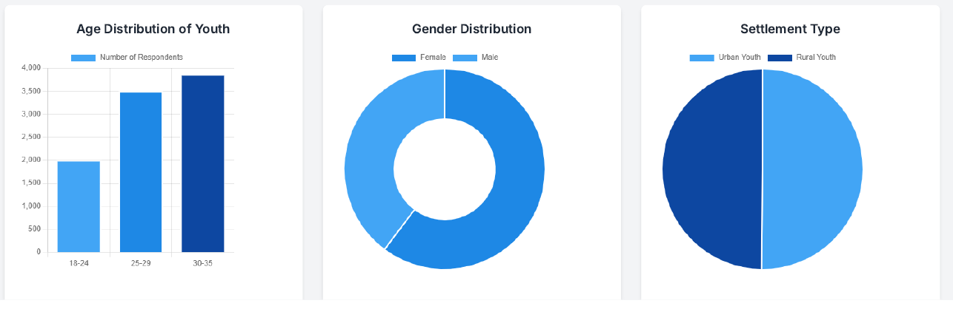
Exploratory Data Analysis (EDA)
Data overview – Source: FinAccess 2024 survey; (10,479 rows × 35 columns)
Key features – age, gender, education, phone/ID access, expenditure.
Target: – Financially Included (1) vs Not Financially Included (0)

Slide 6
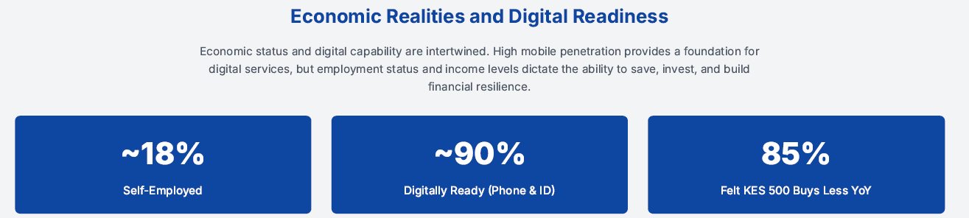
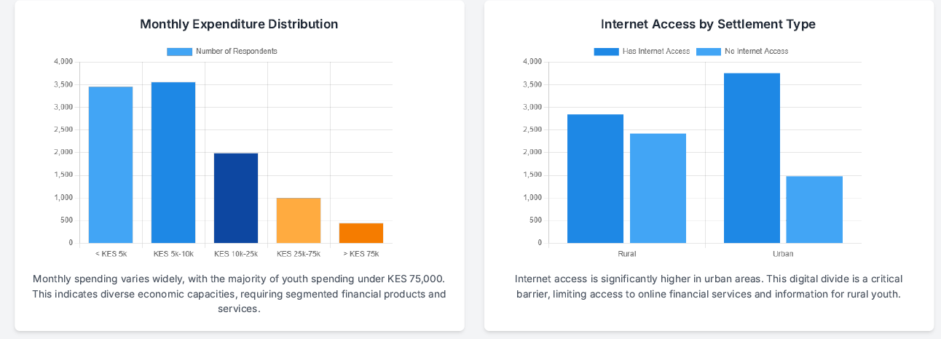
Exploratory Data Analysis (EDA)… cont’d

Slide 7
Data Preparation
Filter: rural youth (age 18–35)
Handling missing values
Feature encoding (one-hot, binary)
Class imbalance handled using ADASYN

Slide 8
Modeling
Logistic Regression
Random Forest
Decision Tree
Models Built and Trained
XGBoost
Gradient Boosting
Naive Bayes
Model Selected
Neural Net (MLP)
Reason for selection (diversity:
interpretable + powerful)

Slide 9
Model – Features Importance

Slide 10
Model Performance
Models with extremely high performance have risk of overfitting and data leakage.

Slide 11
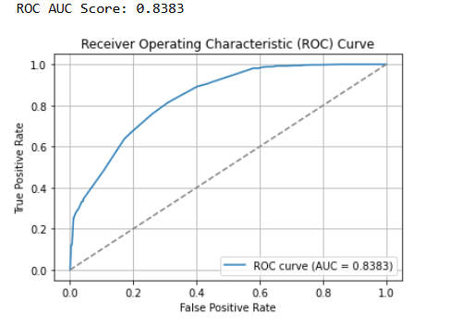
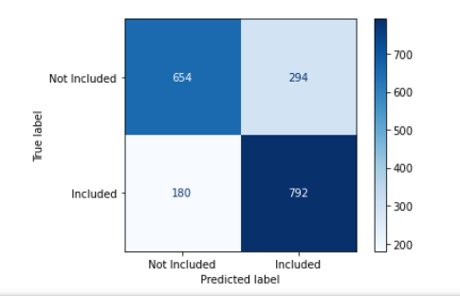
Selected Model – Confusion Matrix, ROC
Confusion matrix

Slide 12
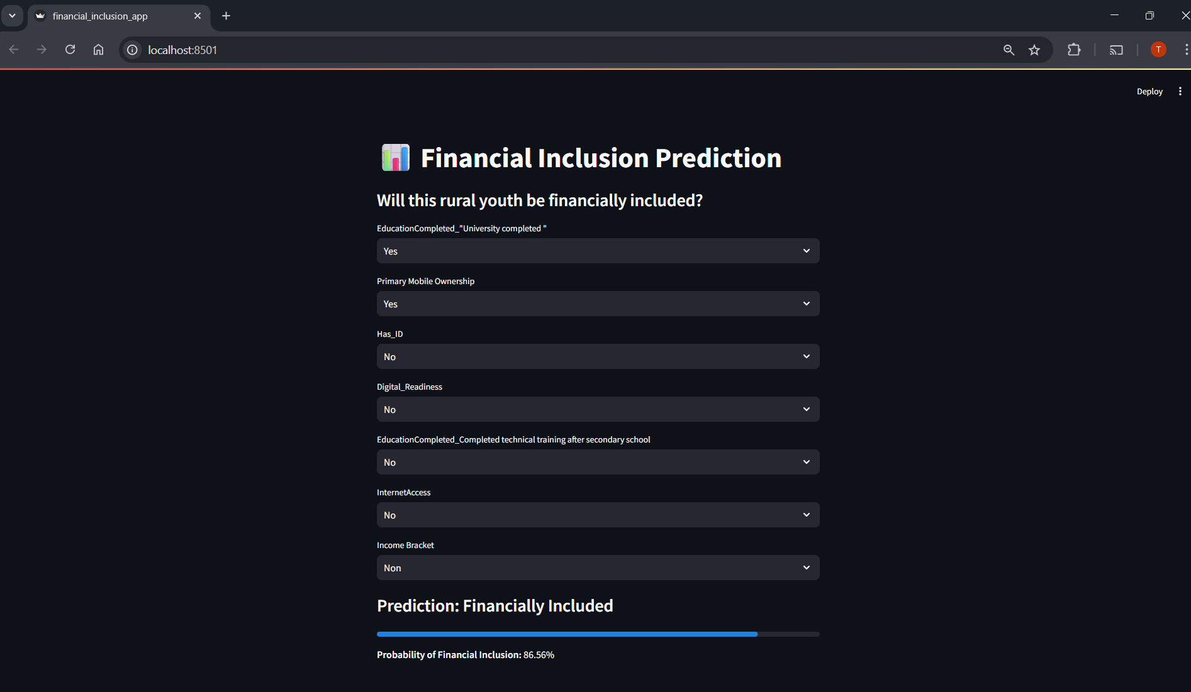
Model Deployment
Deployment App: Streamlit API deployed on port 8501
Input: 7 features
Output: Prediction + probability
Below is a screenshot of API working user interface
Deployed App

Slide 13
Conclusion & Recommendations
Conclusion:
MLP model is robust and provides a good balance across the classes.
Financial inclusion of rural youth is predictable
Targeted interventions such as digital access, education, IDs
Recommendations:
Improve data coverage (geo-tags, telecom access)
Deploy model in financial planning tools or gov dashboards
Collect feedback from users to improve model accuracy

Slide 14

The End…..
Thank You!

